Slide 1
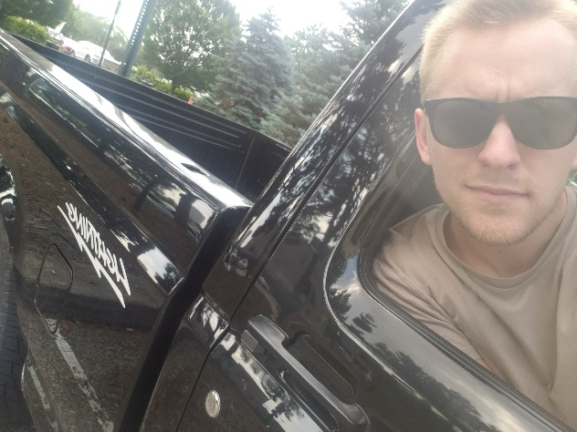
Name: Gage Farmer
Major: Electrical and Computer Engineering
Where you were born: London, Ohio
Where you live: London, Ohio
Work Background: Math and Computer Science tutor
Educational Background: 2 years at Capital University studying CS, an Associates of Science from Columbus State, and I guess I’m a third year here at OSU
Interests/hobbies: Powerlifting, messing with computers, building cars
Favorite movie or show seen or book read in last 6 months: The Sopranos
Interesting Facts: My last name is Farmer, I own a 1942 John Deere tractor, and I have a lot of land out in the country, but I do not farm anything.
Why are you interested in taking this class? It will be useful to understand how to effectively sell decisions to management that will benefit both the engineering team and the company.

